Slide 1


Slide 2
Group 2
Name | ID
Rafiz Imtiaz | 011183088
Tahmina Rahman Dipty | 011183095
Imran Hossain Tushar | 011171244
Rabeya Hossain | 011171276
1

Slide 3
Content
Project Management Tools
- What is PM Tools ?
- Key features of PM tools
- 10 popular PM tools
- Description of the tools
- 3 PM tools cross comparison
- Pricing
- Features
- Pros & Cons
- Users
- Our Project Management tool choosing
2

Slide 4
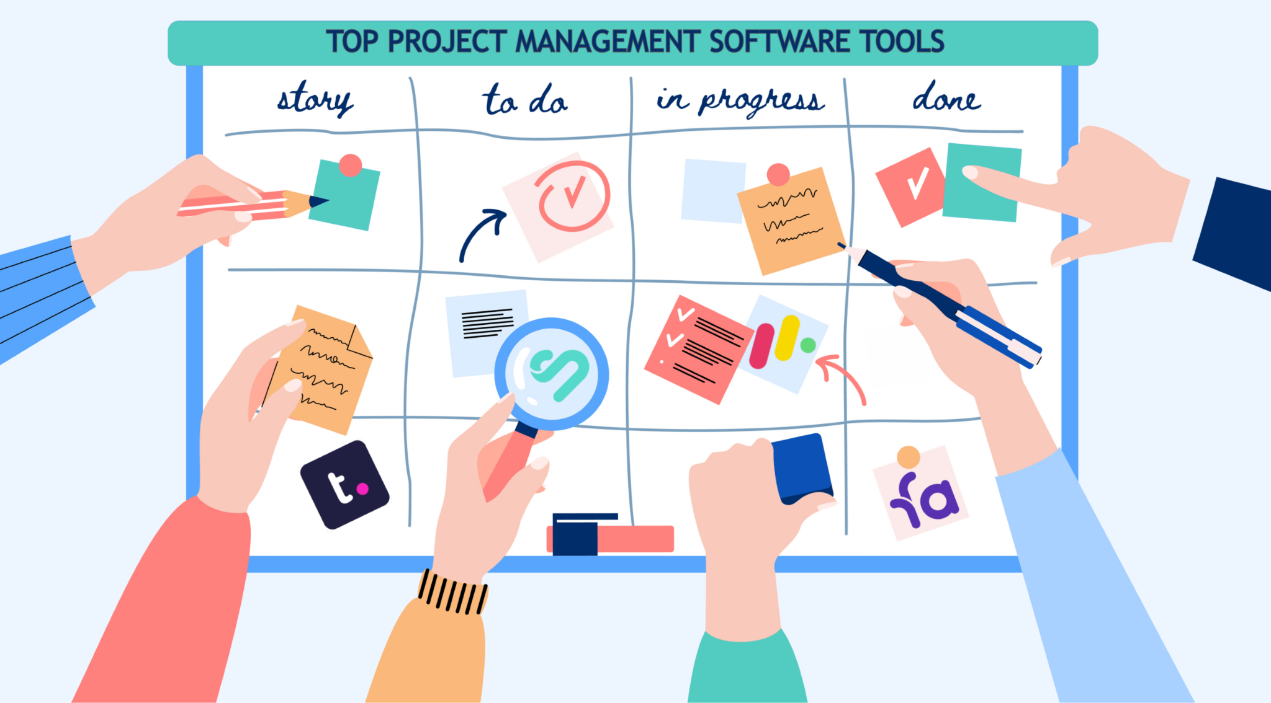
Project Management Tools
A project management tool is software that helps project managers and teams centralized planning, organize and manage their projects.
3

Slide 5
Key features of project management tools
Project planning: PM tools allow teams to create project plans and timelines, helping to define the scope of the project and identify the tasks and resources needed to complete it.
Collaboration: These tools offer various ways for teams to work together and share information, such as team calendars, chat, and file sharing.
Reporting: Helps teams track the progress of their projects and identify potential issues in real-time. By providing regular updates and reports, teams stay informed
about the status of their projects and take action to keep them on track.
4

Slide 6
Time tracking: Enables teams to track the time they spend on tasks, which helps them identify areas where the project may be behind schedule.
Documenting: They provide a central location for storing and accessing all project-related documents, allowing teams to share and access critical project information easily.
Budget tracking: Allows teams to track their project budget and expenses, ensuring that they stay on track and avoid overspending.
5

Slide 7
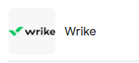


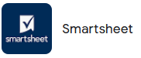
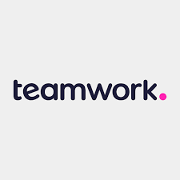

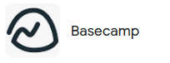
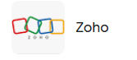
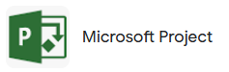

10 popular PM tools
6

Slide 8
1.Wrike
Collaborative
Organization
User Friendly
User Interface
Navigation
2.Asana
Free version includes most features, including automations
Integrations with Zoom, GitHub andmore
Project status reports
3. Monday.com:
Intuitive and visual project management platform.
Facilitates team collaboration and task tracking.
Customizable workflows and automation features.
Integrates with various third-party apps.
4. Smartsheet:
Cloud-based project management and collaboration tool.
Offers spreadsheet-like interface with Gantt chart capabilities.
Enables resource management, budget tracking, and reporting.
Integrates with popular business
applications.
7

Slide 9
5. Jira:
Leading software development and issue tracking tool.
Designed for agile project management and software teams.
Allows for sprint planning, bug tracking, and release management.
Extensive customization options with plugins and extensions.
6. Basecamp:
Simple and user-friendly project collaboration software.
Features task lists, file sharing, and real-time messaging.
Streamlined interface for easy team communication.
Ideal for small to medium-sized projects.
7. Zoho Projects:
Comprehensive project management suite by Zoho.
Offers task scheduling, time tracking, and document management.
Collaboration tools include chat, forums, and notifications.
Integration with Zoho's other productivity applications.
8.Teamwork:
Allows task assignment, time tracking, and resource planning.
Includes document sharing, Gantt charts, and milestones.
Integrates with popular tools like Dropbox, Google Drive, etc.
8

Slide 10
9. Microsoft Project:
Powerful project management software from Microsoft.
Supports project planning, resource allocation, and timelines.
Offers Gantt charts and visual representations of project data.
Integrates with Microsoft Office and other Microsoft tools.
10. ClickUp:
All-in-one project management and productivity platform.
Features, goal tracking, and time tracking.
Customizable views (lists, boards, Gantt) for flexible planning.
Integrates with numerous external apps and services.
9

Slide 11
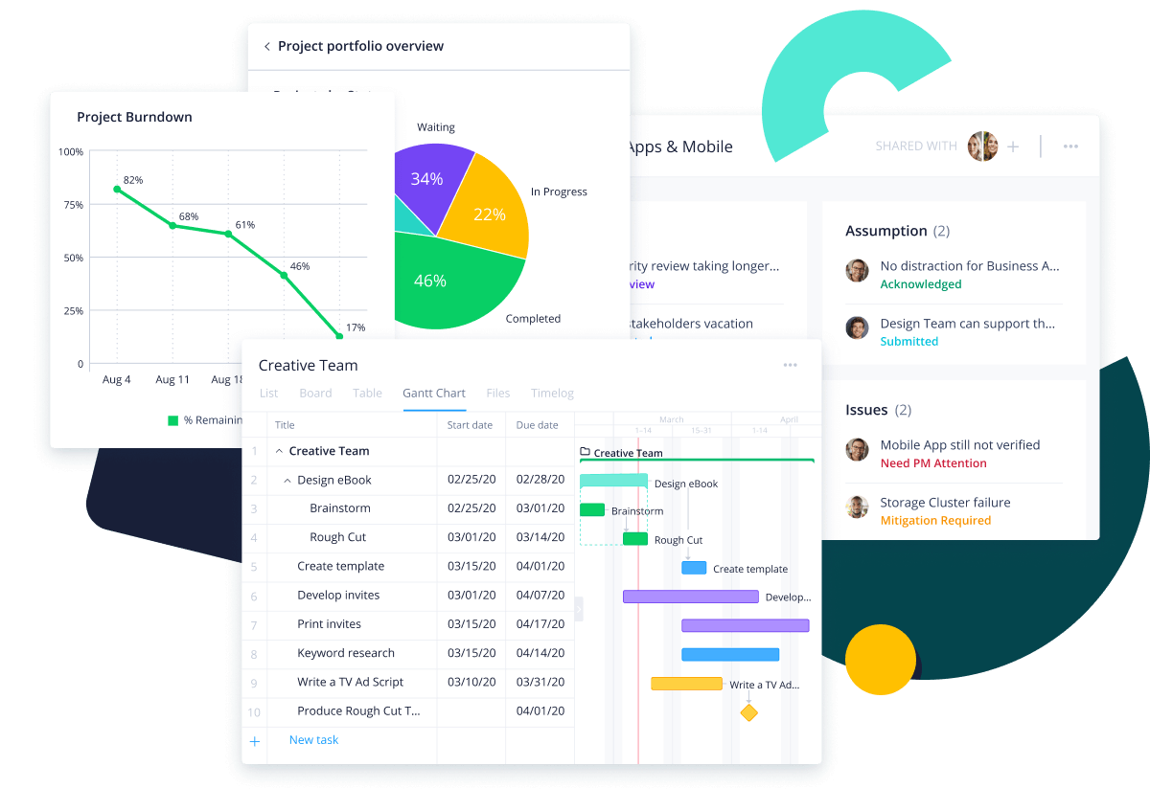
3 PM Tools that we’ve chosen for comparison
1. Wrike
Wrike is an award-winning work management platform, used by more than 20,000 companies and 2.4m people in over 140 countries.
With a suite of tools for everyone from project managers to marketing heads, Wrike is the first choice for teams, departments, and organizations in every industry and field.
11

Slide 12
Wrike Features:
Organized File Management
Collaborative Editing
Kanban & Scrum Board
Easy Time Tracking
Resource Management
10

Slide 13
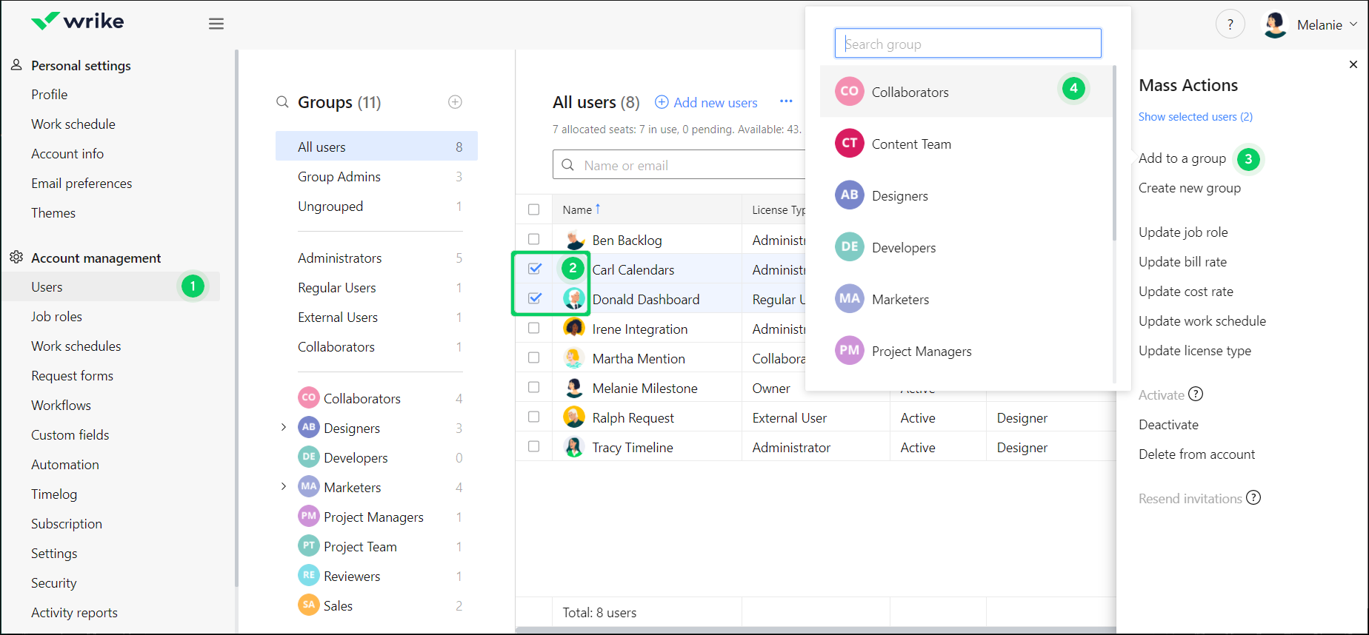
12

Slide 14
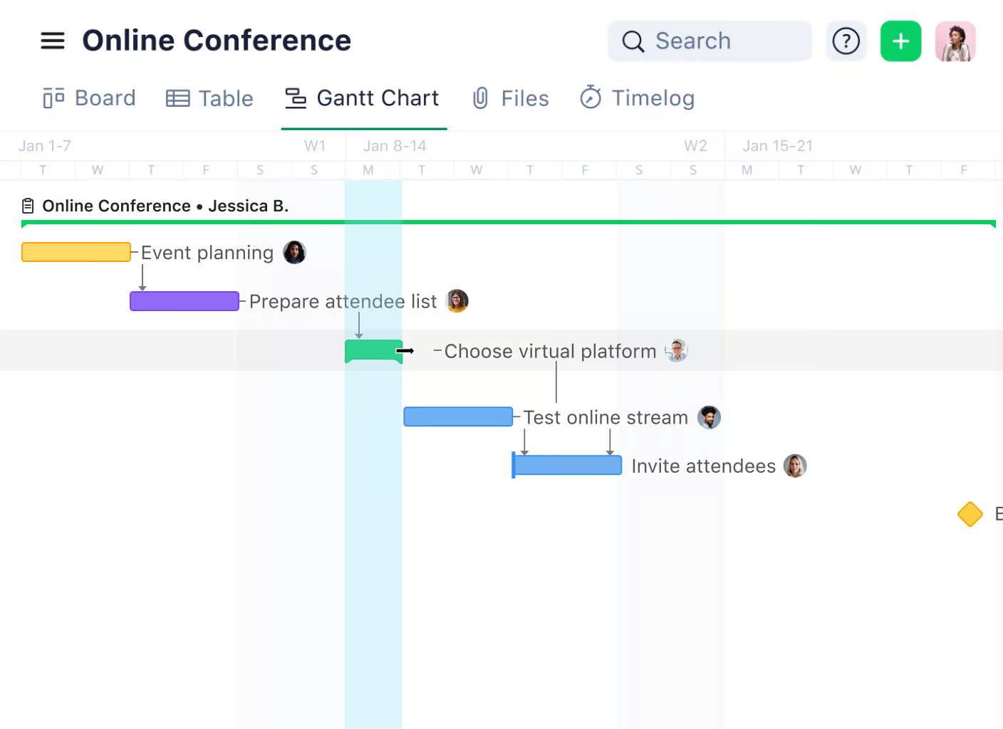
Gantt Chart
13

Slide 15
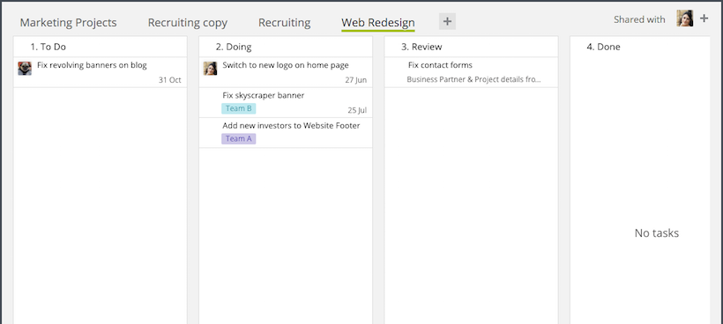
Wrike Kanban Board
14

Slide 16
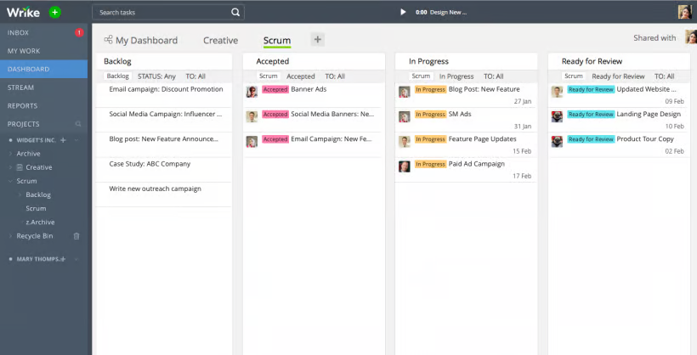
Scrum Board
15

Slide 17
Kanban vs Scrum Board
Points of Comparison | Kanban board | Scrum board
Flow of work | Continuous | Time-boxed sprints
Task Management | Flexible | Planned within sprints
Roles | No predicted roles | Scrum master, product owner, development team
Suitable for projects | Evolving projects | Well defined requirements
Columns | To-do,Work In-progress, Done | Backlog, In progress, verify, done
16

Slide 18
Benefits of Wrike:
Enterprise-level project management capabilities
Detailed analytics and insights to calculate deliverables
Two-factor authentication support
Limitations of Wrike:
Interface is difficult to navigate
Mobile apps have limited functionality
The platform can be too expensive
17

Slide 19
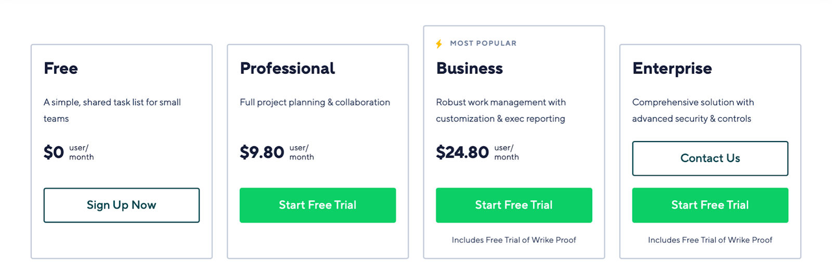
Pricing:

Slide 20
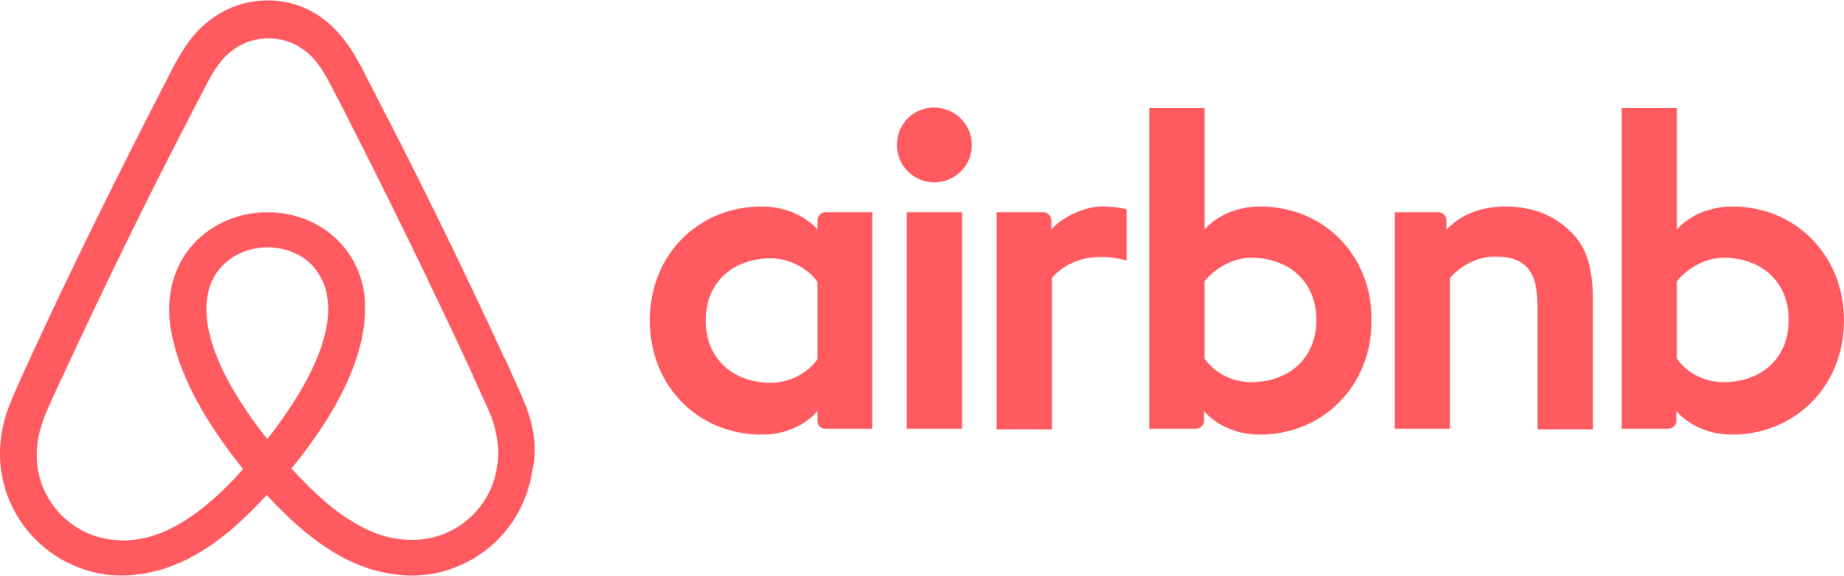







Users of Wrike
18

Slide 21
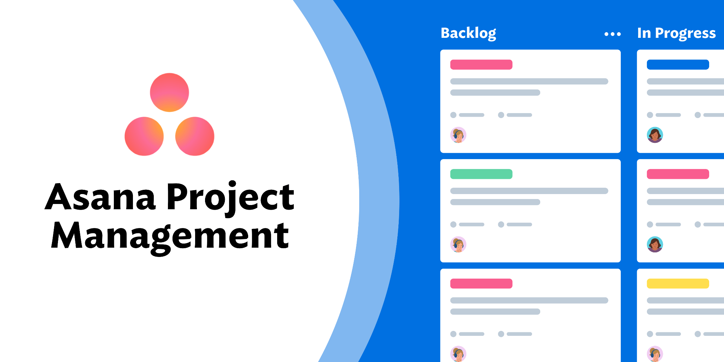
2. Asana
Asana is one of the more popular project management software platforms available.
Built for businesses of many sizes, this multifaceted tool combines file storage, project roadmaps, dashboards, and more in one attractive interface.

Slide 22
Asana Features:
Task Prioritization
Task Comments and Conversations
Kanban-style Views
Assign due dates to tasks
Get reminders and notifications as deadlines approach.

Slide 23
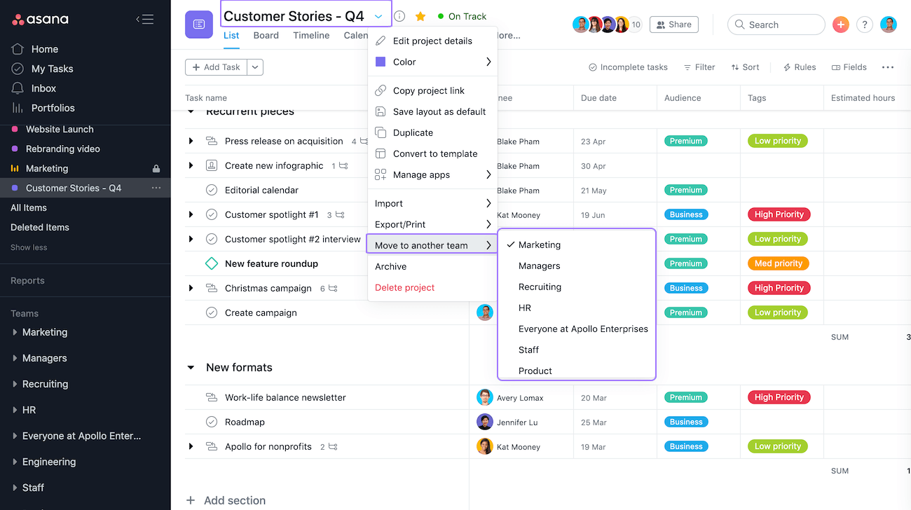

Slide 24
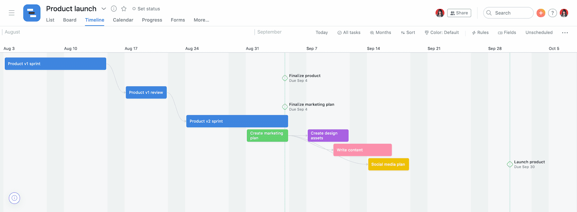
Gantt Chart

Slide 25
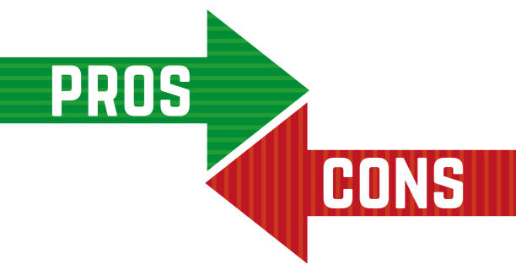
Easy to use
Team collaboration
Customizable views
Integrations
Automation
Complexity
Pricing
Limited time tracking
Limited reporting
Limited flexibility

Slide 26




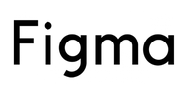


Users of Asana

Slide 27
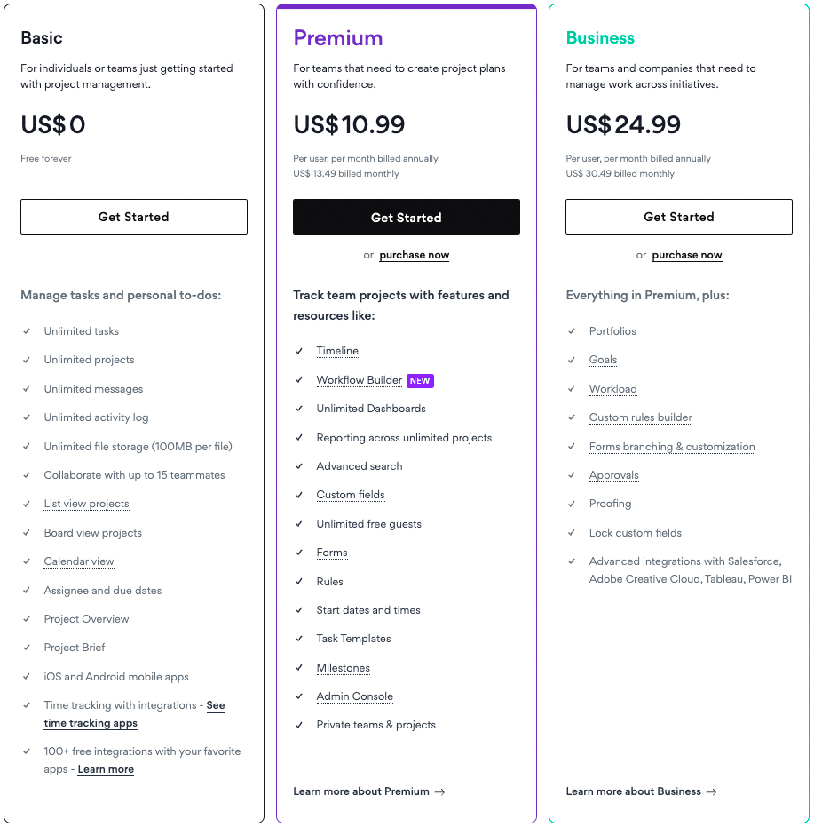
Pricing
Wrike is right by trying out its 30-day free trial.
Paid plans start at $9.80 per month for 2-25 members and $24.80 for 5-200 user for business purpose.
25

Slide 28
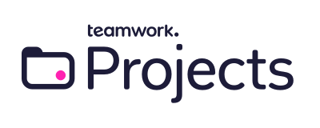
3. Teamwork
Teamwork.com is the only project management platform built specifically for client work.
Teamwork's customers track and manage their projects with a suite of integrated solutions such as helpdesk, collaboration, knowledge sharing, and customer relationship management add-ons, enabling.
Teamwork.com to be the 'one-stop shop' solution for business owners.

Slide 29
Teamwork Features:
File Sharing and Document Management
Video Conferencing and Audio Calls
Notifications and Alerts
Access Control and Permissions
Feedback and Commenting
Automation process & scheduling
27

Slide 30
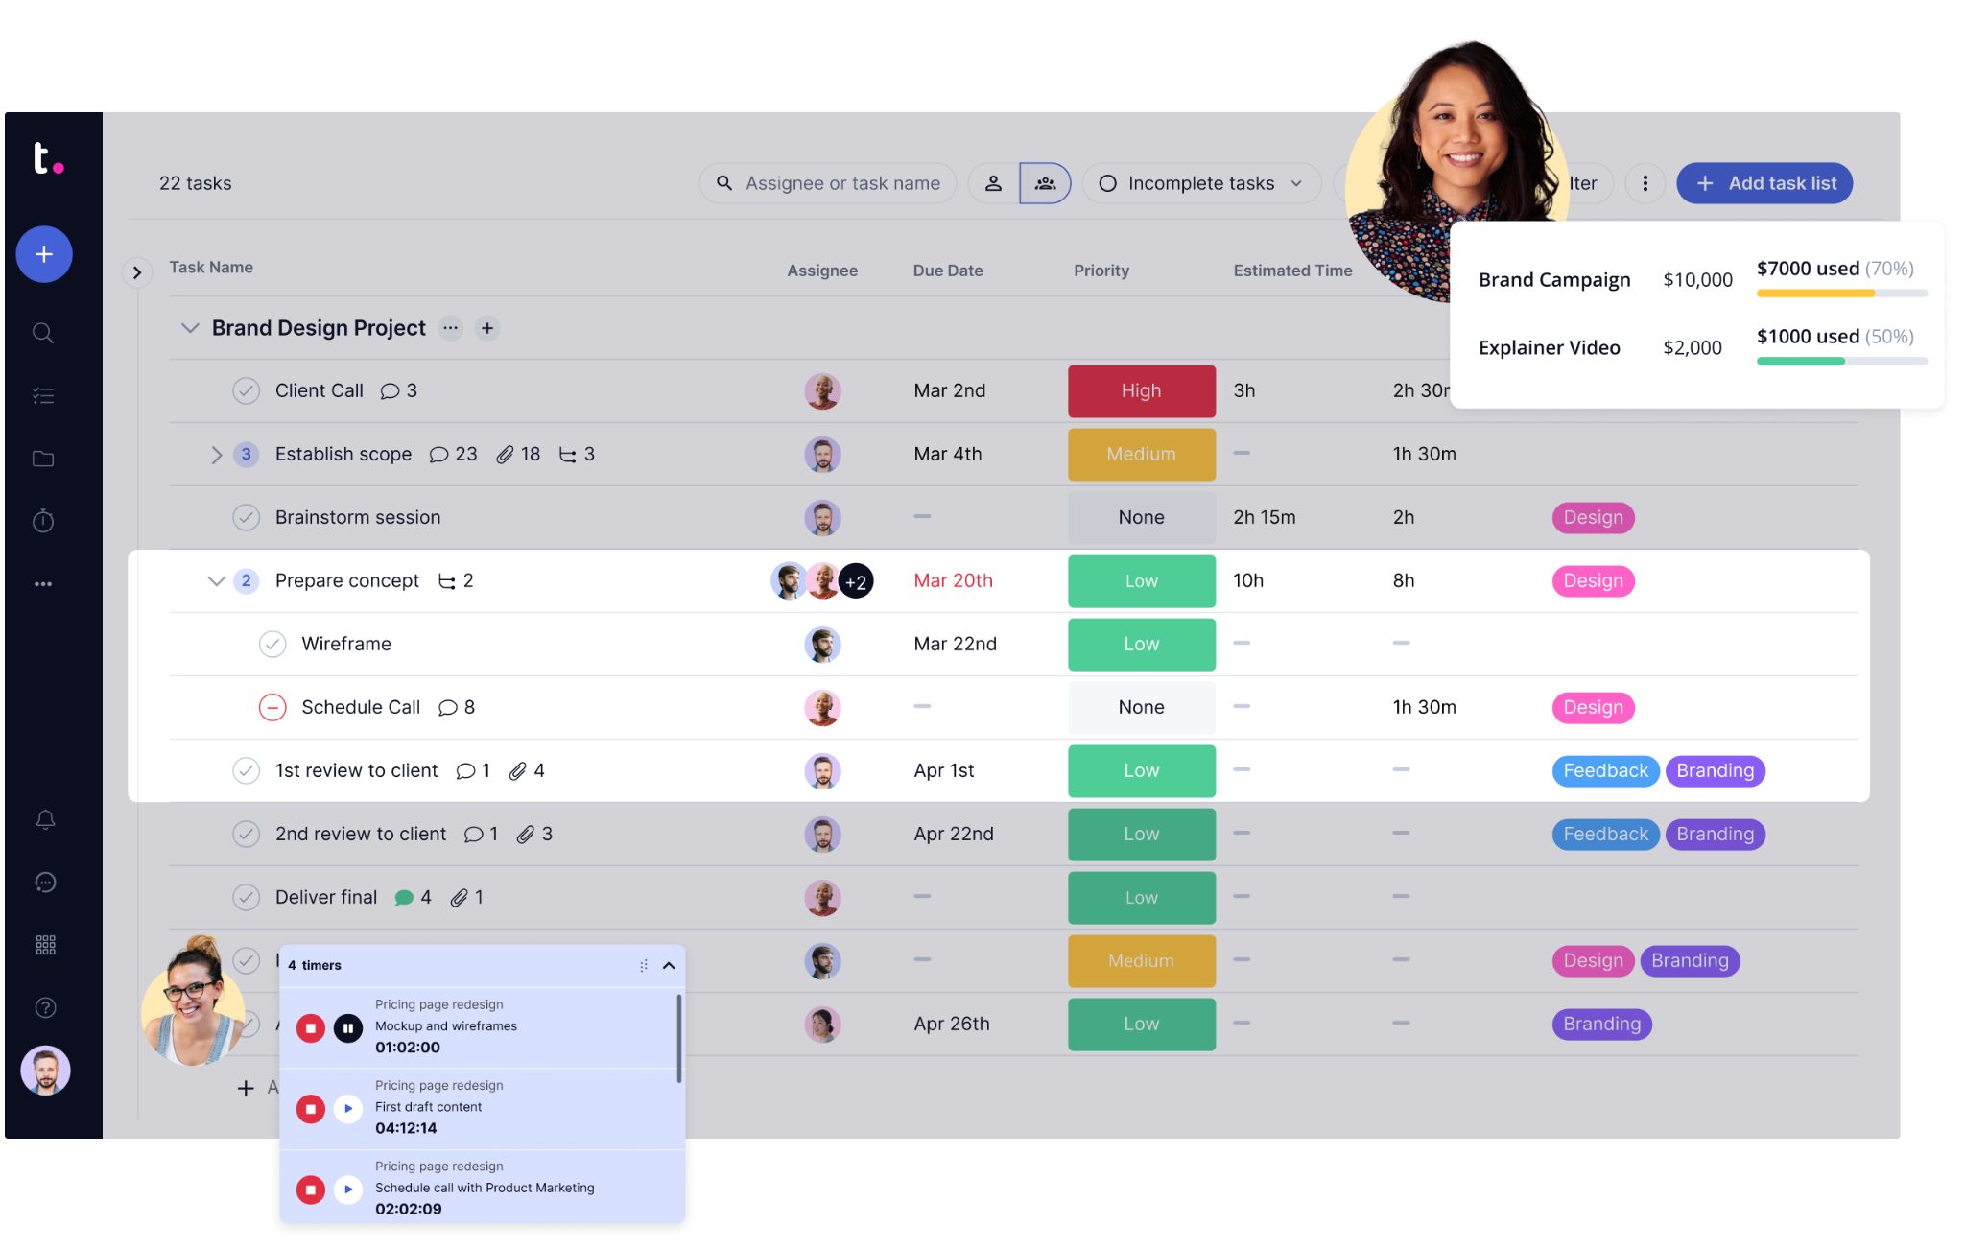

Slide 31
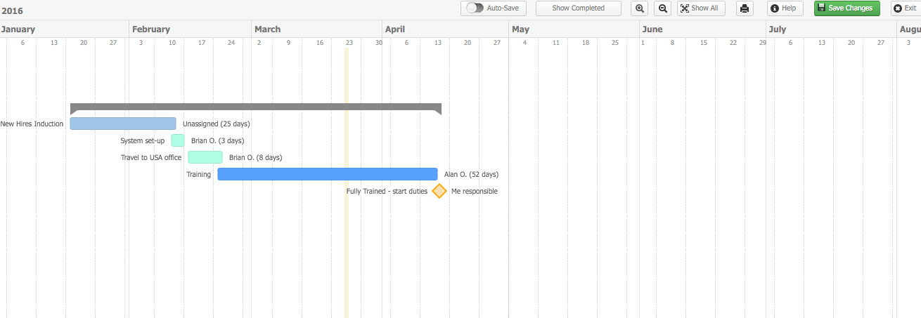

Slide 32
Use of Teamwork
Project views include lists, tables, boards and Gantt.
Integration with over 350 tools.
Teamwork has a Google Chrome extension and Gmail add-on, allowing users to use the tool from their browser and create tasks via the Gmail app.
Project risk management features provide information about project risk probabilities.
Resource management capability.
Time tracking capability is especially beneficial for contractors and location-independent teams

Slide 33
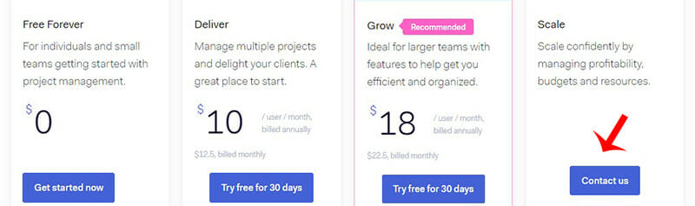
Pricing
Paid plans start at $5.99 per month per user, billed annually.
Teamwork is right for you by trying out its 30-day free trial.
31

Slide 34




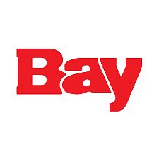



Users of Teamwork

Slide 35
Comparison by features | Wrike | Asana | Teamwork
Issue Tracking system | Yes | No | Yes
Document management | Yes | No | No
Project portfolio management | Yes | Yes | No
Workflow system | Yes | Yes | Yes
Budget management | No | No | Yes
Time tracking | Yes | Yes | Yes
Resource management | Yes | Yes | No
Automation | No | No | Yes

Slide 36
Comparison | Wrike | Asana | Teamwork
Pricing Plan | Free - $0 Team - $9.80 per user/month (billed annually) Business - $24.80 per user/month (billed annually) Enterprise - Custom pricing for large teams (billed annually) Pinnacle - Custom pricing for teams with complex needs. | Basic - $0 Premium - $13.49 per user/month (billed monthly) Business - $30.49 per user/month (billed monthly) Enterprise - Custom | Free Forever - $0 (for 2 projects and up to 5 users) Deliver - $10/user/month billed annually (or $12.50/user/month when billed monthly). Grow - $18/user/month billed annually (or $22.50/user/month when billed monthly).
Customers Rating | It has a Capterra rating of 4.3/5 (2,400+ customers). | It has a Capterra rating of 4.5/5 (12,000+ customers). | It has arating of 4.5/5 (816+ customers).
34

Slide 37
Comparison | Wrike | Asana | Teamwork
Reviews | Customers feel that its interface is intuitive. One of the biggest mentioned benefits is the ability to update in real time, which allows for easy and enjoyable collaboration between teams. | Customers are positive about the ease in which they can keep team members informed and up to date with project information. Some customers are unsure about the interface. | Teamwork is a great project management tool for teams that need an easy-to-use solution. The user interface is quite intuitive and straightforward.
Integrations | more than 400 app integrations. | more than 200 app integrations. | Integration with over 350 tools.

Slide 38
Comparison | Wrike | Asana | Teamwork
Support | offers an exceptional level of support, with award-winning assistance that scales with your business. Help is available 24/7 with upgradeable support packages. | there is no phone support or live chat available, which makes it challenging to get fast answers. | Email or Live chat support.
Head Office | San Jose, California. | San Francisco, California , US | Cork, Ireland.

Slide 39
PM tool for our project
After comparing all these tool we came to our reasoning, why & what tool should we use for our project.
We chose teamwork.com for our project management tools. We are a group of 5 member and we want to have a tool which have everything included. The free trial offers upto 2 projects and 5 people with unlimited time limit
Here’s few key reasons why we chose this tool:
Complete Collaboration Suite
User-Friendly Interface
Efficient Task Management
Versatile Project Views
Seamless Integrations
Customizable Workflows
Reliable Support
Automation
37

Slide 40
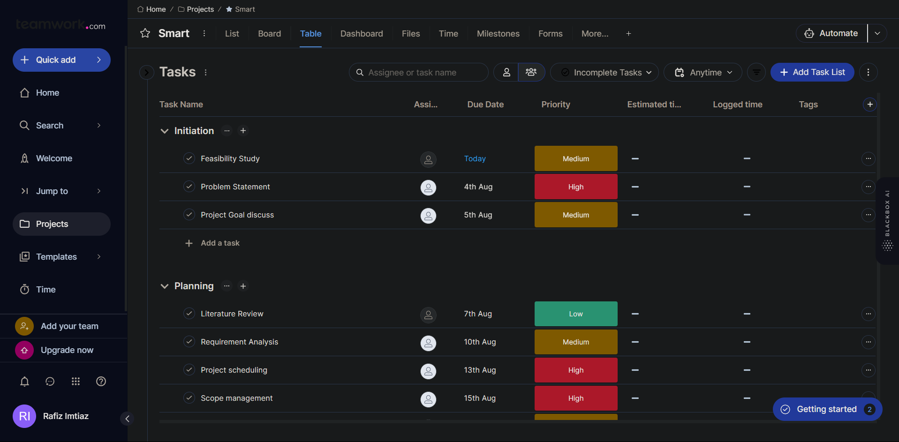
List view:

Slide 41
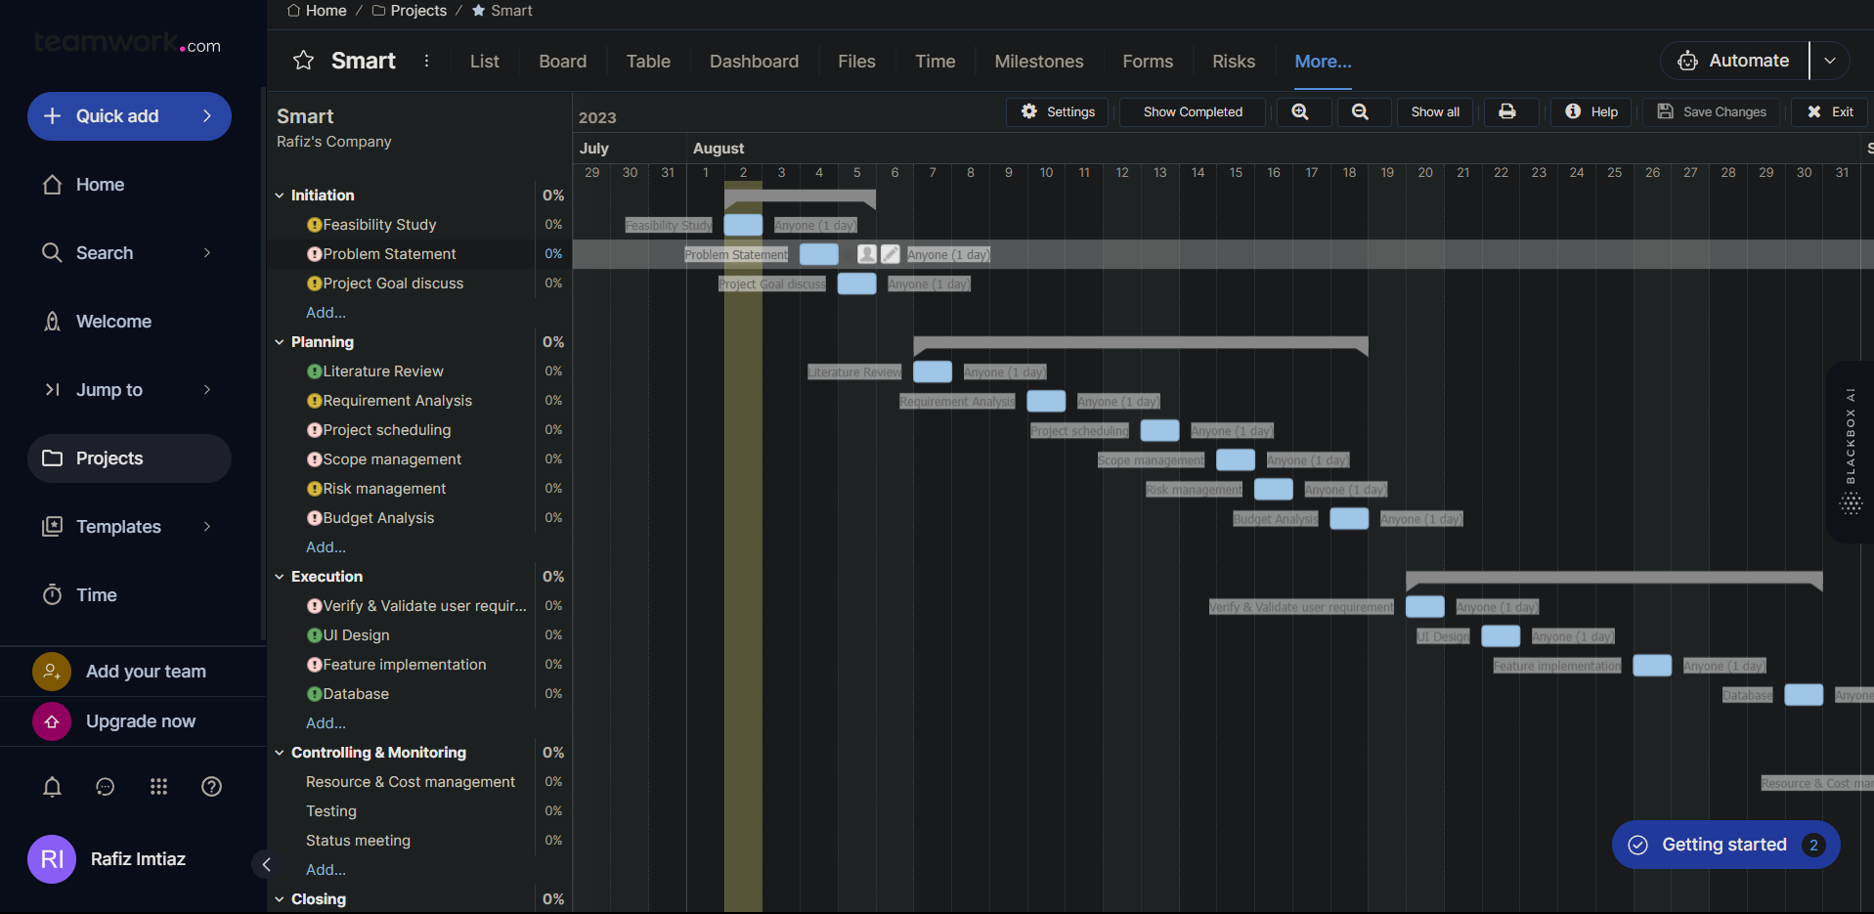
Our Gantt Chart
39

Slide 42
Thank You

